Slide 1
Chapter 4 Part II
Time-Dependent Failure Models
The Normal Distribution
LogNormal Distribution
Gamma Distribution
Chapter 4
Notes:
While the CFR model is perhaps the simplest in its mathematical structure, it has limited application. Obviously, not all failures modes have constant failure rates. Three important failure distributions are the Weibull, normal, and lognormal having non-constant failure rates.

Slide 2


The Normal Distribution
Ok, But what’s a normal deviate?
I understand that the lecture will return to normal.
I really liked those Weibull’s
Chapter 4

Slide 3
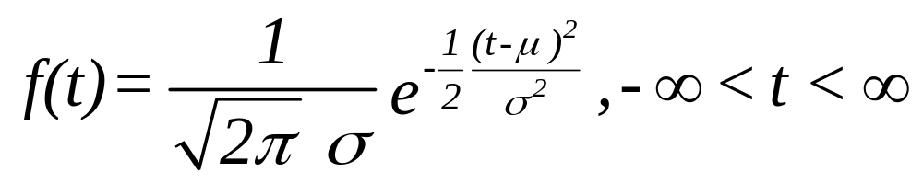
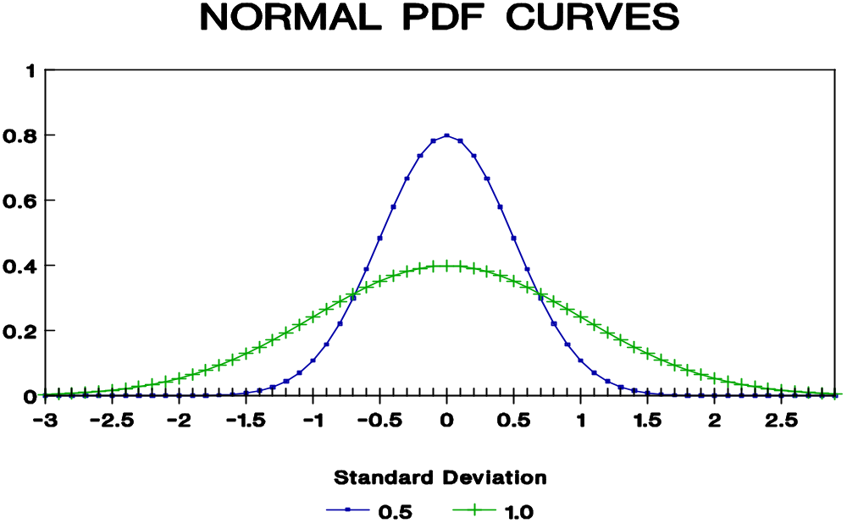
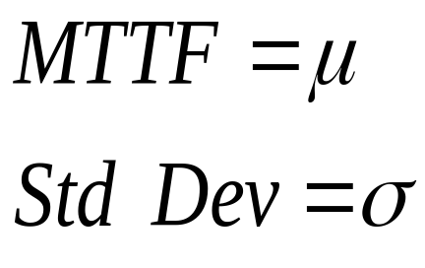
The Normal Probability Density Function
Chapter 4
Notes:
Let us get back to normal. You should already be familiar with this distribution. We start with the density function and graph. The normal has a location parameter (the MTTF) and a scale parameter (the variance or standard deviation). There is no shape parameter since it always has the bell-shape curve. Notice that the domain of a normally distributed random variable goes from negative infinity to plus infinity. Is this a good property for a failure distribution? What is the domain of the exponential and Weibull?

Slide 4
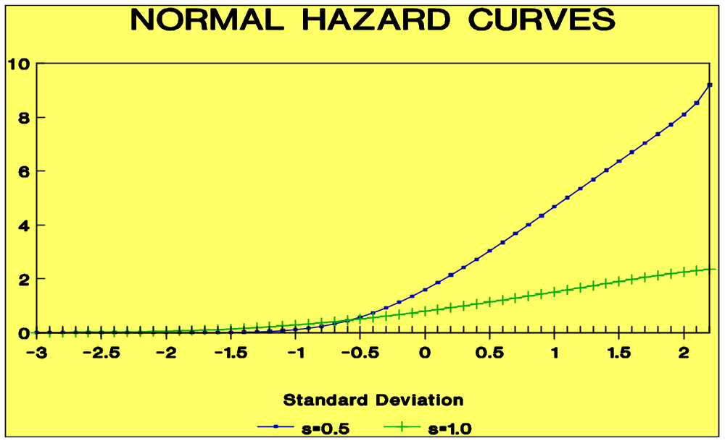
Normal Hazard Rate Function
f(t) / R(t)
IFR
Chapter 4
Notes:
Interestingly, the hazard rate function is always increasing. Therefore, we would never want to use this distribution for modeling manufacturing defects that are gradually removed. The hazard rate function can only be determined numerically because we cannot integrate in closed form the normal PDF.

Slide 5


Normal Distribution - Applications
Tool failures
Brake lining wear
Tire tread wear
It’s the additive effect of temperature variation, material wear, friction, and other random stresses over time, isn’t it?.
Chapter 4

Slide 6
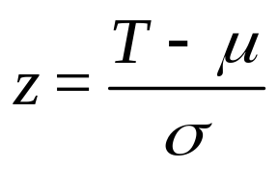
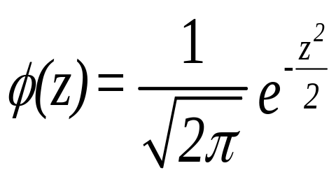
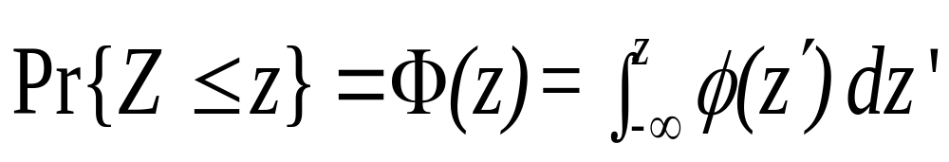
Finding Normal Cumulative Probabilities
If T is normally distributed, then let
Then z has a normal distribution with a mean of 0 and a standard
deviation of 1. The PDF for z is given by
Its cumulative distribution is then given by
z is the standardized normal deviate
Chapter 4
Notes:
To find normal probabilities, we standardize by subtracting the mean and dividing by the standard deviation. This generates an equivalent normal random variable having a mean of zero and a standard deviation of one. For this random variable, tables of cumulative or (complementary cumulative) probabilities are available. (there is one in the back of the text). Make note of the above notation for the standardize normal PDF and CDF. Is it all Greek to you?

Slide 7
Normal Probability Tables
Z Φ(Z) 1-Φ(Z)
-0.55000 0.29116 0.70884
-0.54000 0.29460 0.70540
-0.53000 0.29806 0.70194
-0.52000 0.30153 0.69847
-0.51000 0.30503 0.69497
-0.50000 0.30854 0.69146
-0.49000 0.31207 0.68793
-0.48000 0.31561 0.68439
-0.47000 0.31918 0.68082
-0.46000 0.32276 0.67724
-0.45000 0.32636 0.67364
-0.44000 0.32997 0.67003
Pr{Z < -.5} = .30854
Pr{Z > - .46 = .67724
Chapter 4
Notes:
An example of the normal probability table given in the Appendix (A.1) of the text. Be sure you can se this or some other normal table (you are welcome to use your favorite normal table for the duration of the course).

Slide 8
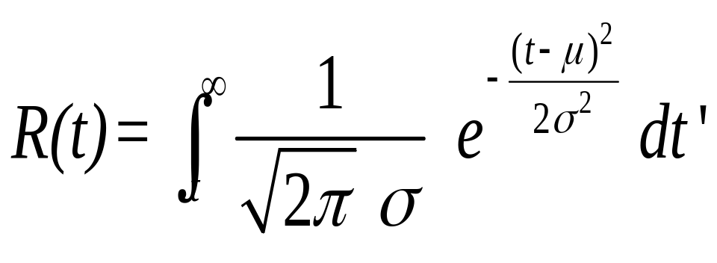
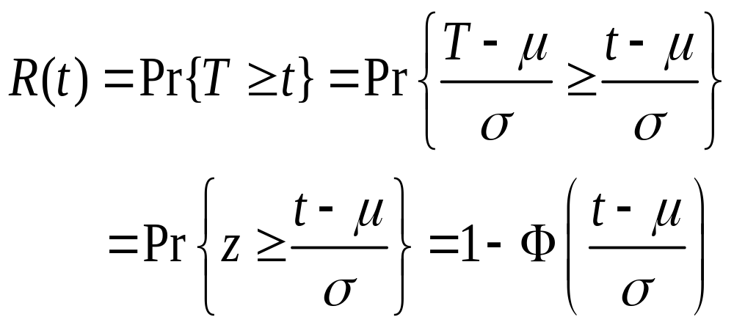
Normal Reliability Function
Chapter 4
Notes:
To find normally distributed reliabilities, we standardize and then go to the normal table.

Slide 9
Example Problem - Normal
The time to failure of a fan belt is normally distributed with a MTTF = 220 (in hundreds of vehicle miles) and a standard deviation of 40 (in hundreds of vehicle miles).
R(100) = 1 - Φ[ (100-220)/40] = 1 - Φ(-3) = .99865
R(200) = 1 - Φ[ (200-220)/40] = 1 - Φ(-.5) = .69146
R(300) = 1 - Φ[ (300-220)/40] = 1 - Φ(2) = .02275
R(100|200) = R(300) / R(200) = .02275 / .69146 = .0329
note: both the median and mode = MTTF = 22,000 miles
Chapter 4
Notes:
Check these reliabilities with the table values.

Slide 10
Normal Example problem - design life
A new fan belt is developed from a higher grade of material. It has a time to failure distribution which is normal with a mean of 35,000 vehicle miles and a standard deviation of 7,000 vehicle miles. Find its designed life if a .97 reliability is desired.
R(t) = 1 - Φ[ (t - 350)/70] = .97; find t !
From the normal table, 1 - Φ(-1.88) = .96995
Therefore; (t - 350 ) / 70 = -1.88
and t_{.97} = 350 - 1.88 (70) = 218.4 or 21,840 vehicle miles
Chapter 4
Notes:
Be sure you can work a problem in reverse to find a design life. In this case, we enter the normal table with a reliability (complementary cumulative probability) and find the corresponding z value. Then we solve for t using the relationship t = μ + σ z. For a design life of .90, what is the corresponding z value? What should the sign of z be, positive or negative?

Slide 11
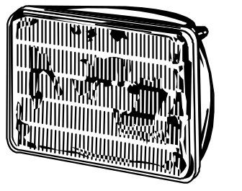
Student Exercise - Normal
The operating hours until failure of a halogen headlamp is normally distributed with a mean of 1200 hr. and a standard deviation of 450 hr.
Find:
a. The 5 year reliability if normal driving results in the use of the headlamp an average of .2 hr. a day.
b. The .90 design life in years.
Chapter 4
Notes:
Try your luck with one; answers follow.

Slide 12
Student exercise - solution
a. t = .2 hr./da. x 365 da./yr. x 5 yr. = 365 hr.
R(365) = 1 - F[ (365 - 1200)/450] = 1 - F[ -1.86] = .96856
b. R(t_{.90}) = .90
or 1 - F[ (t_{.90} - 1200)/450] = .90
( t_{.90} - 1200 ) / 450 = -1.28
t_{.90} = 1200 - 1.28 (450) = 624 hr.
or t_{.90} = 624 / (.2 x 365) = 8.5 yr.
Chapter 4
Notes:
Be sure you can work this type of a problem.

Slide 13

The Lognormal Failure Process
some normal logs
Let T = a random variable, the time to failure. If T has a lognormal distribution, then the logarithm of T has a normal distribution.
Chapter 4
Notes:
As we deviate from the normal, we turn our attention to the lognormal. The lognormal has often been used a repair distribution. Later on we will discuss maintainability and the repair probability distribution in detail. We will be taking advantage of the relationship between the normal and the lognormal distribution. (Perhaps that is where it gets its name; what do you think?)

Slide 14
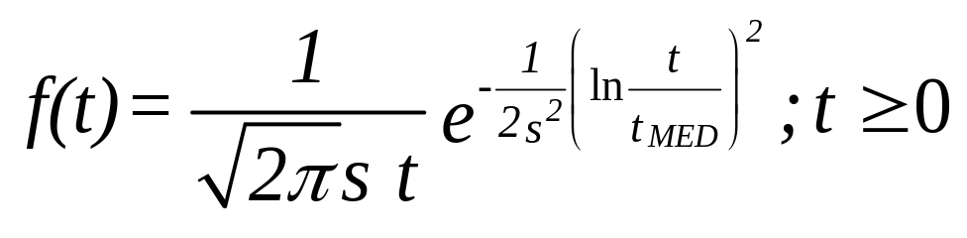
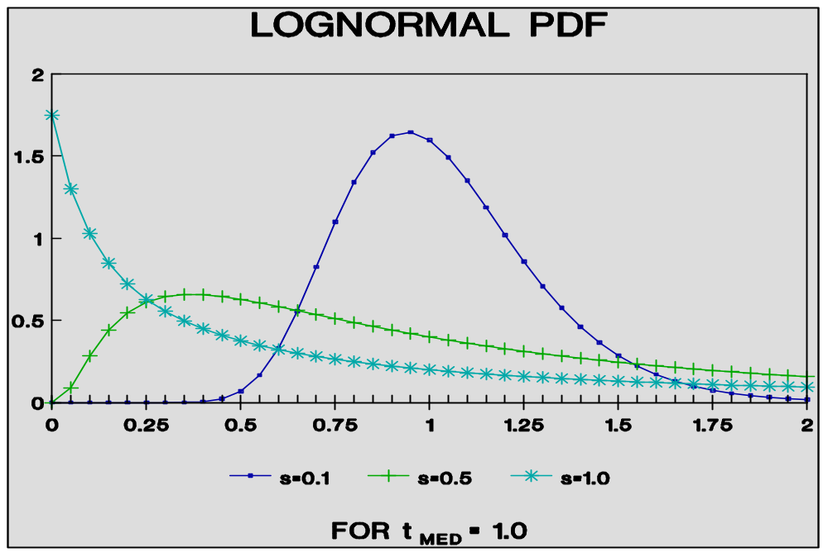
Lognormal Density Function
t_{med} = median time
to failure
s = shape parameter
Chapter 4
Notes:
The PDF look almost like the normal PDF. We will define the parameters of the lognormal to be its median (a location parameter) and its shape parameter s. Others will define the parameters of the lognormal in terms of the mean and standard deviation of the underlying normal distribution. Therefore, you must be careful and always be aware of how the parameters are being defined when using this distribution. As you will see, there are formulae for converting from one set to the other.

Slide 15
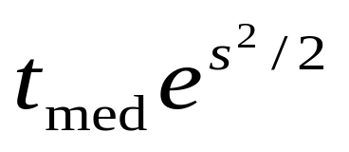
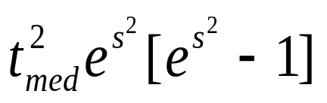
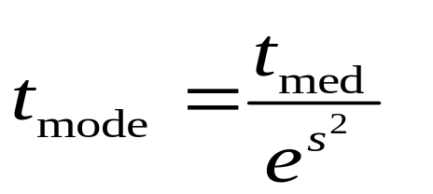
Lognormal/Normal Relationship
Given T is a lognormal random variable, then
T Log T
Distribution Lognormal Normal
Mean ln t_{med}
Variance s²
Mode ln t_{med}
Chapter 4
Notes:
Hey! Here are the formulae. The natural log of the median of the lognormal distribution is the mean of the underlying normal. The shape parameter of the lognormal is the standard deviation of the underlying normal. Don’t confuse the mean and standard deviation of the underlying normal with the mean and standard deviation of the lognormal. The lognormal is entitled to have its own mean and standard deviation. You need o be able to use all of the above relationships.

Slide 16
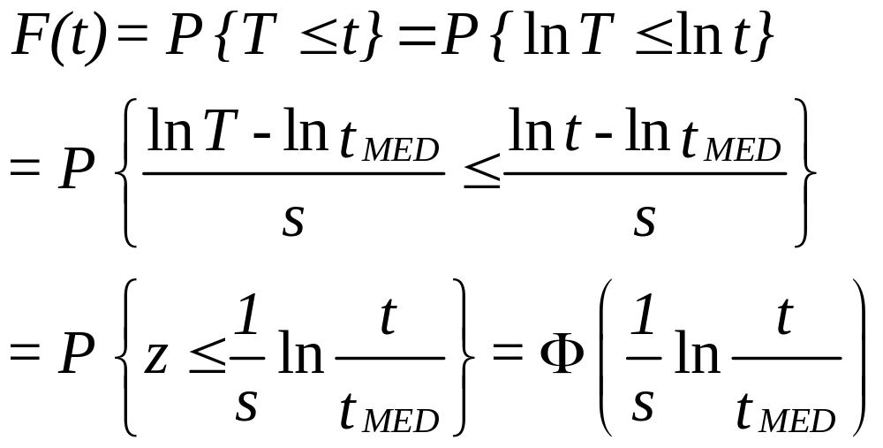
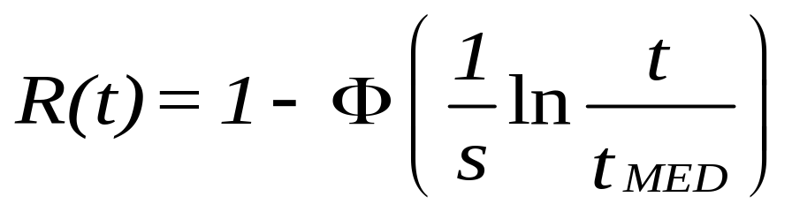
Lognormal Failure & Reliability Distribution
Chapter 4
Notes:
“How do I find lognormal reliabilities,” you ask? Quite simply, we use the underlying normal distribution and the normal table. Can you follow the above steps to get an expression for R(t)? If not, you might ask your instructor to talk you through it.

Slide 17
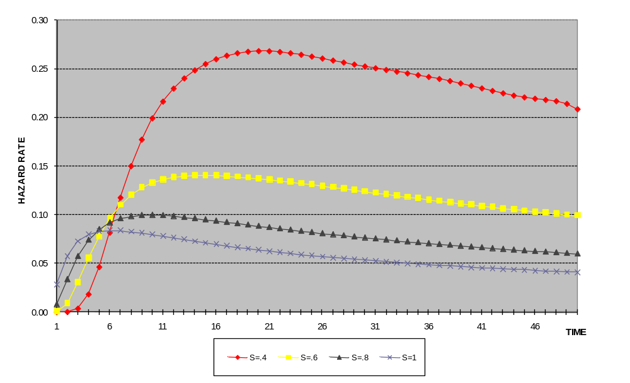
Lognormal Hazard Rate Function
t_{med} = 10
Chapter 4
Notes:
The lognormal has an interesting, almost exciting, hazard rate function. As you can see from the graphs, over time it is increasing until it reaches a maximum point, and then it gradually decreases. Can you describe a failure process that behaves in this way? If so, share it with your instructor. If the lognormal is used as a repair distribution, then the this function become an instantaneous repair rate. How would you interpret its behavior as a repair rate function?

Slide 18
Lognormal Hazard Rate Function
s 1.0 .8 .6 .4
Mode 3.7 5.3 7.0 8.5
MTTF 16.5 13.8 12.0 10.8
Max λ(t) 7 10 16 20
t_{med} = 10
Chapter 4
Notes:
Here are examples of four lognormal hazard rate functions having different shape parameters. If the maximum point, where the failure rate begins to decrease, occurs at a large value of t (relative to the MTTF and the mode of the distribution), then for all practical purposes the lognormal distribution will have an IFR. This will only happen if the shape parameter’s value is small.

Slide 19
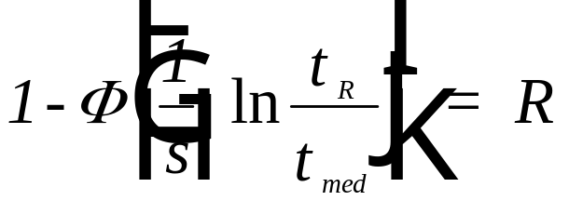
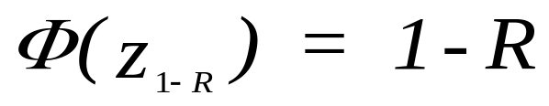
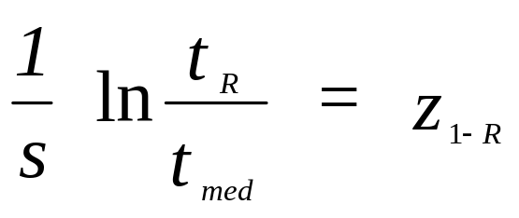
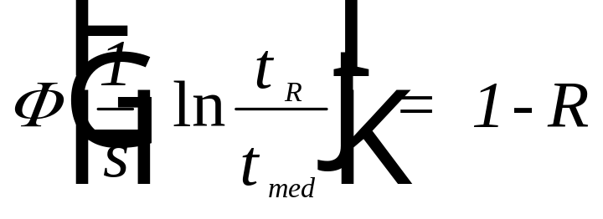
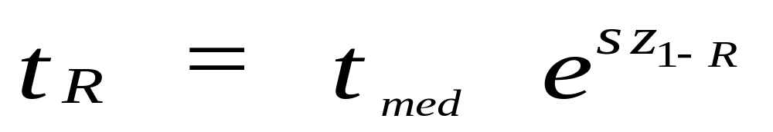
Design Life
Find z_{1-R} such that:
Chapter 4
Notes:
The derivation of the design life (and hence the median) is straightforward. To find a design life, the normal probability table will be used. First,
R is specified,
then the corresponding z value found in the normal table,
and finally the formula shown is used to find t_{R}.

Slide 20

Lognormal Example
The failure distribution of an exhaust system is lognormal with t_{med} = 50,000 vehicle miles and s = .8. Therefore:
a. MTTF = 50,000 e^{.64/2} = 68,856 mi.
b. t_{mode} = 50,000 / e^{.64} = 26,640 mi.
c. variance = 50,000² e^{.64} [e^{.64} - 1] and the standard deviation = 65,195 mi.
Chapter 4
Notes:
Let’s put all this theory to practice. An example suitable for the discriminating student.

Slide 21
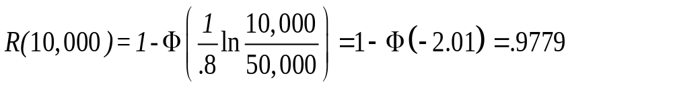
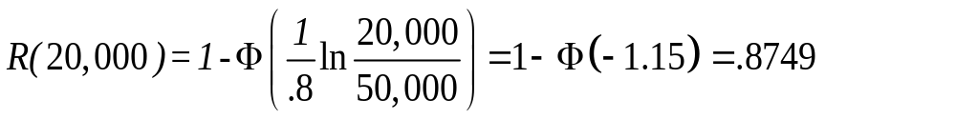
Lognormal Example (continued)
R(10,000 | 10,000) = R(20,000) / R(10,000) = .8749 / .9770 = .8955
Chapter 4
Notes:
Finding lognormal reliabilities is not only easy, its fun!

Slide 22
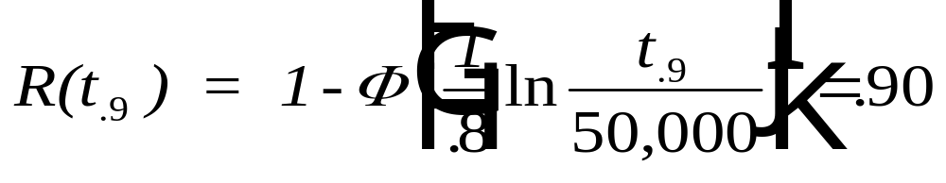
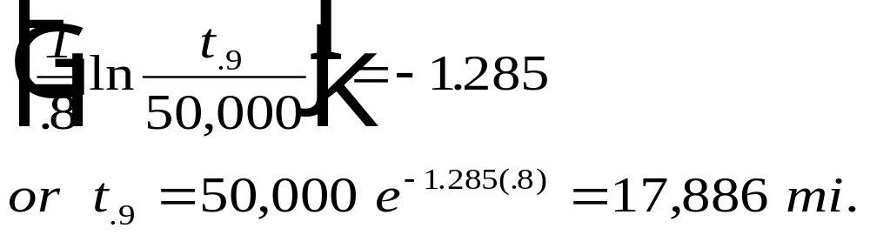
Example (continued)
Find the design life corresponding to a 90 percent reliability.
from the normal probability tables:
Chapter 4
Notes:
Ah ha! The design life.

Slide 23

Class Exercise - Lognormal
Reliability testing of the new 1.6 liter automotive engine has resulted in a time to failure distribution which is lognormal with t_{med} = 100,000 mi. and s = .70. Find:
a. R(36,000 mi.)
b. MTTF and Std. Dev.
c. R(100,000|36,000)
d. t_{.95}
Chapter 4
Notes:
Now its your turn. There is a severe penalty if you look ahead at the answers before you have tried solving the problem.

Slide 24

Class Exercise - solution
a. R(36,000) = 1 - Φ[ (1/.7)ln(36,000/100,000]
= 1 - Φ[ -1.46] = .92786
b. MTTF = 100,000 e^{.49/2} = 127,762 mi.
Var = 100,000² e^{.49} [ e^{.49} -1] = 1.032 x 10¹⁰
Std Dev = 101,594 mi.
c. R(64,000|36,000)
= R(100,000)/R(36,000)
= 5. / .92786 = .539
Chapter 4
Notes:
Be sure you can solve lognormal problems.

Slide 25
Class Exercise - solution
d. R(t_{.95}) = .95
1 - Φ[ (1/.7) ln(t_{.95} /100,000) ] = .95
(1/.7) ln(t_{.95} /100,000) = -1.645
t_{.95} = 100,000 e^{-1.645 x .7} = 31,616 mi.
general approach:
t_{R} = t_{med} e ^{z x s}
Chapter 4
Notes:
You may think that it does not get any better than this. However, you will be mistaken. Wait until you see what lies ahead in the next chapter.

Slide 26
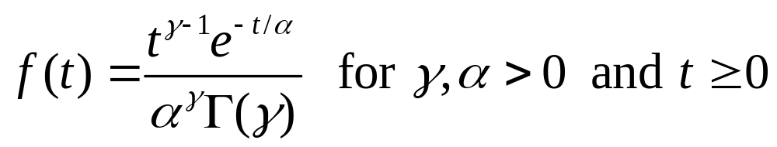
The Gamma Distribution
γ - shape parameter
α - scale parameter
When γ = 1, the resulting distribution is exponential with a mean equal to α.
Chapter 4

Slide 27
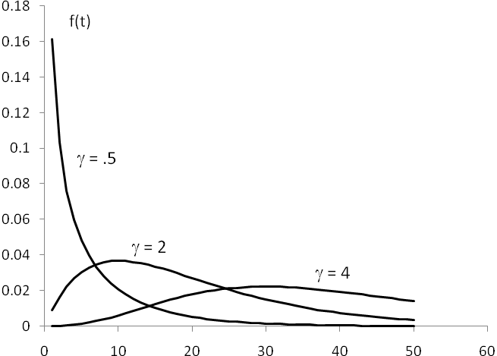
The Density Function Graphed
Chapter 4

Slide 28
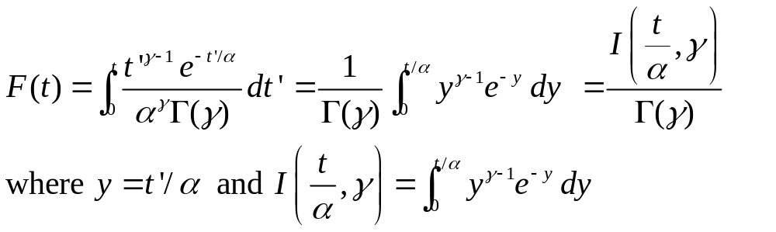
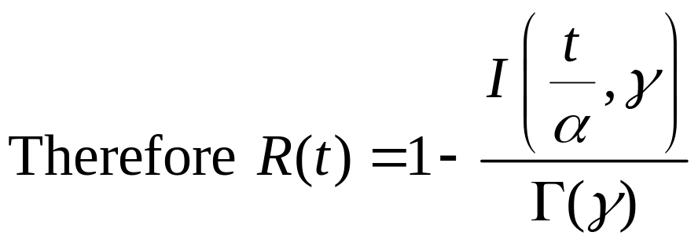
The Reliability Function
Chapter 4

Slide 29
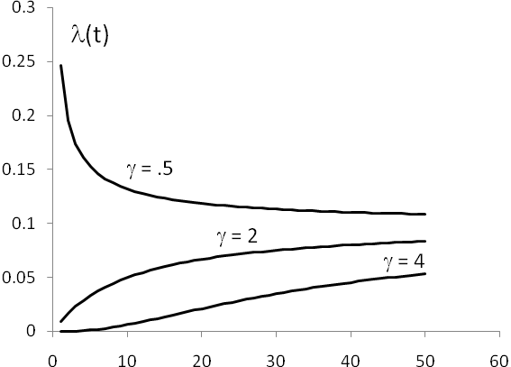
The Hazard Rate Function
asymptotically approaches1/α as t → ∞.
λ = 10
Shape parameter | Hazard rate function
0 < γ < 1 | DFR
γ = 1 | CFR
γ > 1 | IFR
Chapter 4

Slide 30
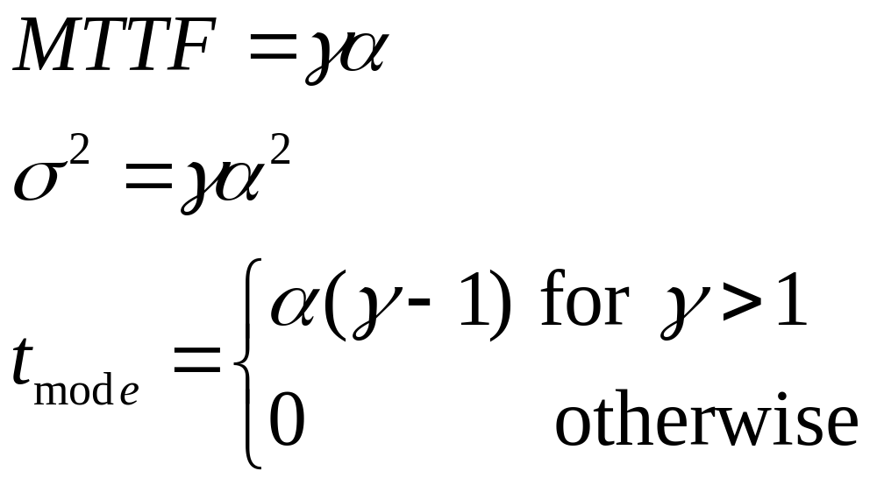
Distribution Characteristics
Chapter 4

Slide 31
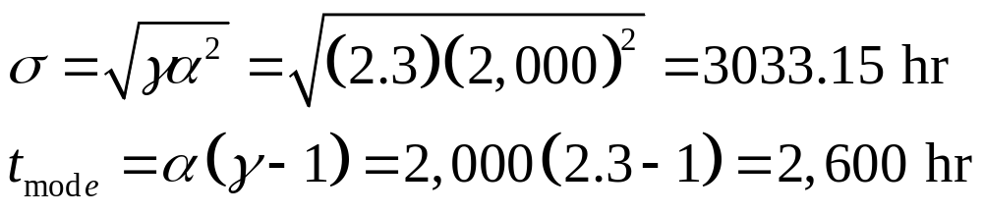
EXAMPLE 4.11
Failures of a critical machine part due to cyclical vibration has a gamma distribution with a shape parameter of 2.3 and a scale parameter of 2,000 operating hours. Then
MTTF = γα = (2.3) (2,000) = 4600 hr
Using the Excel Chapter 4 template for the gamma distribution the median is found to be 3,953.25 hr and R(1000) = .9463
Chapter 4

Slide 32
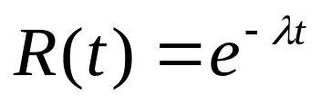
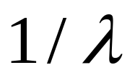
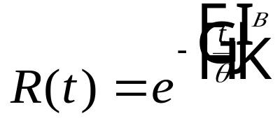
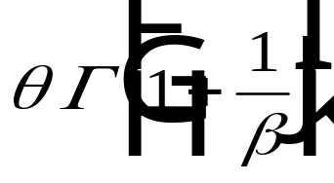
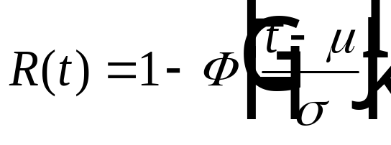

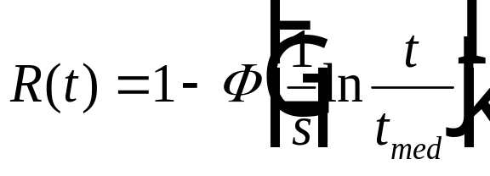
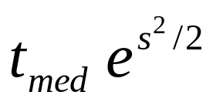
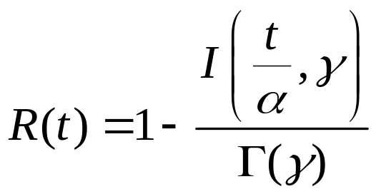
Summary
Reliability
MTTF
Exponential
Weibull
Normal
Lognormal
αγ
Gamma
Chapter 4

Slide 33

That’s all folks!
I cannot wait to work the
Chapter 4 problems and to
start reading Chapter 5!
Chapter 4

